Slide 1


DATA221 Intro Machine Learning 07 logistic regression
William Trimble
Winter 2023

Slide 2
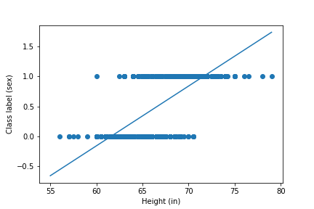
Linear regression on Galton height data
Linear regression on
indicator variables..
not the best we can do
Really? Why not?
Linear discriminator functions
select a special dimension
out of R^{D} which is the direction
the difference lies..
leaves a R^{D-1} dimensional
hyperplane dividing the
vector space of features in half.

Slide 3
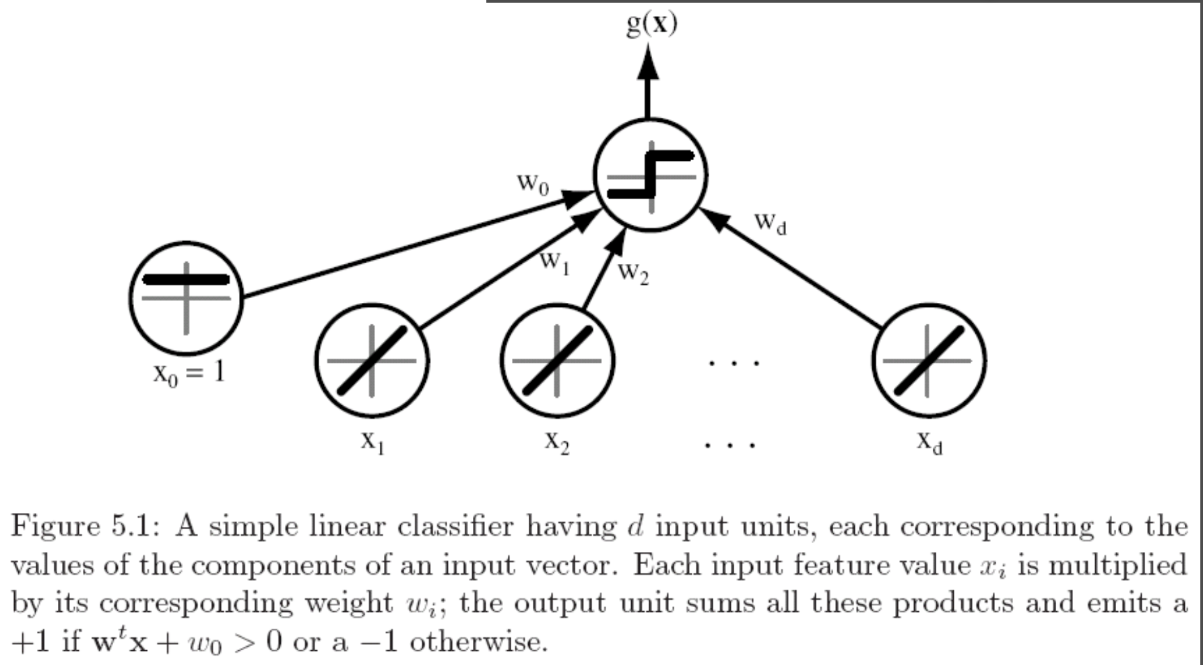
Linear classifier
Prediction(X, w) = g(w₀ + w^{T} X )
Nonlinear function; “activation function”
Duda, Pattern Classification

Slide 4
Wait, not so fast, this is one of those equations that hides a lot of complexity
Prediction(X, w) = g(w₀ + w^{T} X )
y = g(w₀ + w^{T} X )
n observations
k dimensions
in y
r features for each
observation in x
( _ x _ )

Slide 5
Wait, not so fast, this is one of those equations that hides a lot of complexity
Prediction(X, w) = g(w₀ + w^{T} X )
y = g(w₀ + w^{T} X )
n observations
( _ x _ )
( _ x _ )
( _ x _ )
( _ x _ )
r features for each
observation in x
k dimensions
in y

Slide 6
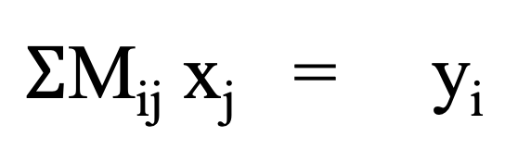
Non-square matrix multiplication….
M x = y
$Σ$M_{ij} x_{j} = y_{i}
n
M
x
x
y
x
=
n
n x r
r x 1
n x 1

Slide 7
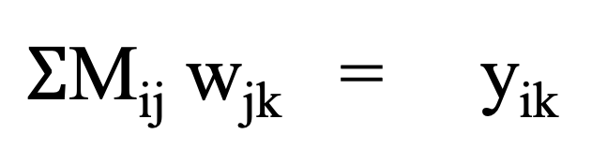
Non-square matrix multiplication….
M w = y
$Σ$M_{ij} w_{jk} = y_{ik}
r
k
k
M
y
y
r
=
square
matrix
n
n x r
r x k
n x 1

Slide 8
Features and labels as matrices…
r features
k labels
X
Y
n examples
n examples / individuals / observations
n examples
n x p
n x r
This is the form a lot of our library functions will expect.

Slide 9
Features and labels as matrices…
r features
n labels
n examples / individuals / observations
r features ( in X ) (predictors)
1 outcome variable (Y)
X
w
=
Y
n examples
n x r
r x 1
n x 1

Slide 10
Features and labels as matrices…
n x k multidimensional labels
r features
n examples / individuals / observations
r features ( in X ) (predictors)
k outcome variables (Y)
X
w
=
Y
n examples
n x r
r x k
n x k

Slide 11
Features and labels as matrices…
n x k multidimensional labels
r features
n examples / individuals / observations
r features ( in X ) (predictors)
k outcome variables (Y)
X
w
=
Y
n examples
n x r
r x k
n x k
For our penguins:
n is the number of penguins ( about 300)
r is the number of features measured (4), and MASS, FLIPPER LENGTH, BEAK LENGTH, BEAK DEPTH
k is the number of predictor variables of interest ( 3 species, 1 sex)

Slide 12
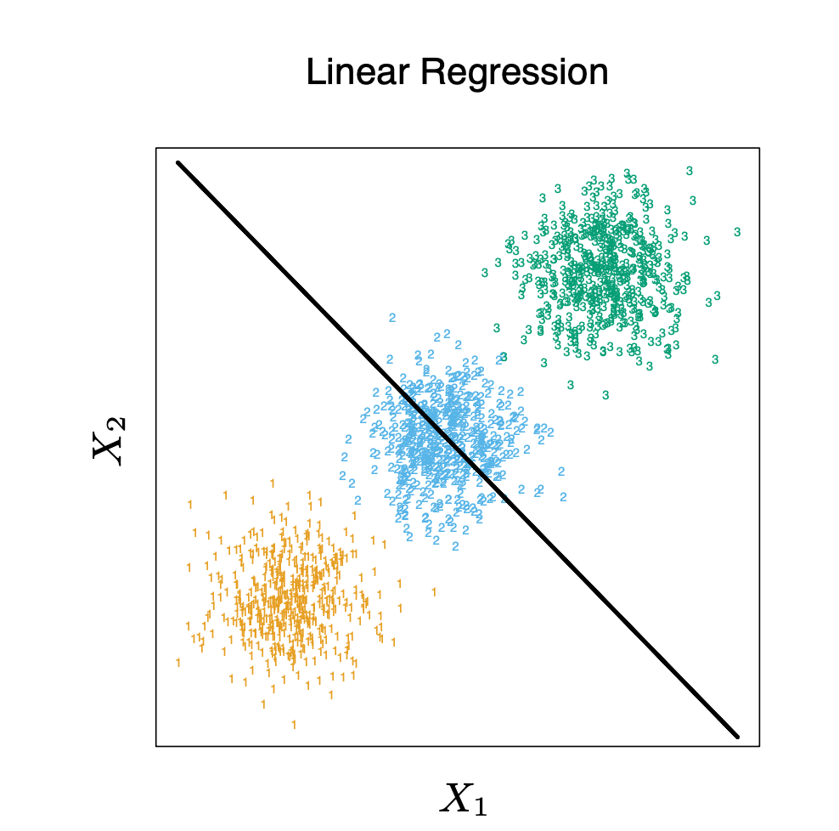

Slide 13
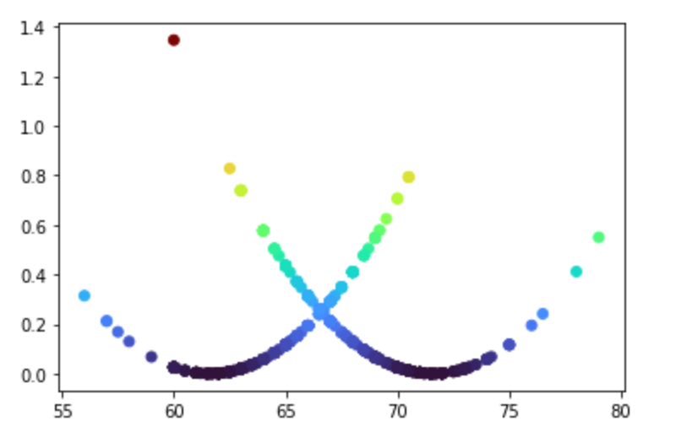
SSE loss function for Galton height data
SSE loss funciton
Height (in)

Slide 14
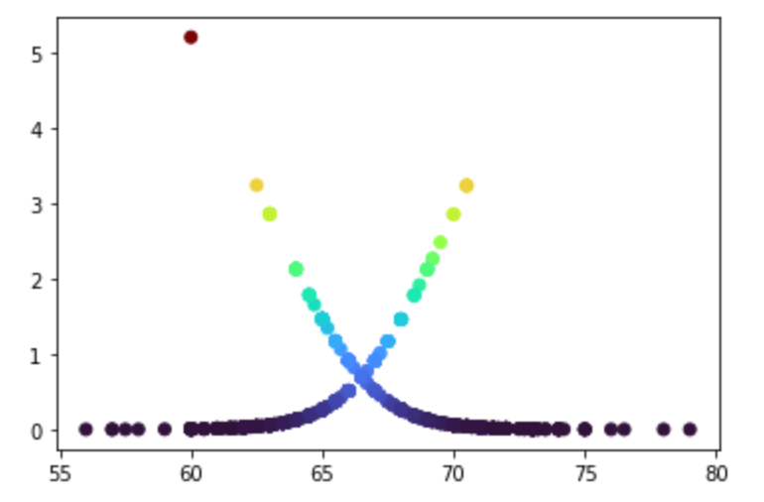
Logistic loss function on Galton height data
Logistic loss function
Height (in)

Slide 15
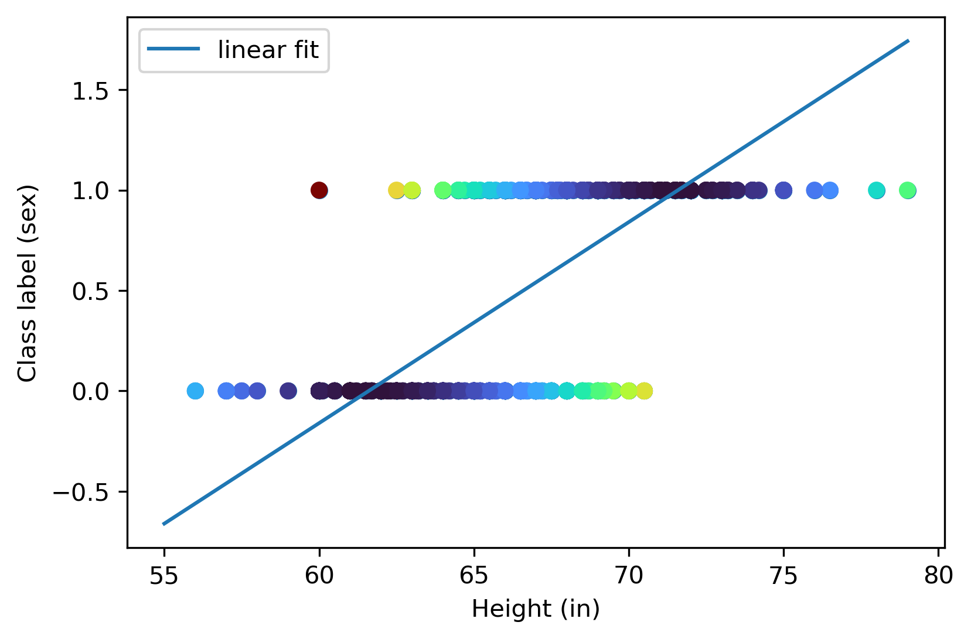
Linear regression on class label

Slide 16
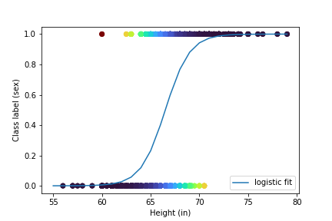
Logistic regression on class label

Slide 17
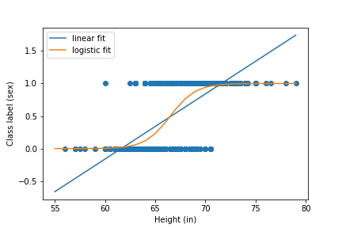
Logistic regression on Galton height data

Slide 18
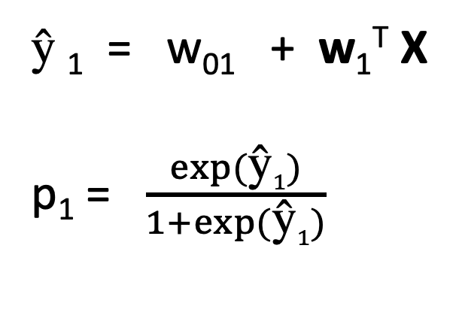
Logistic regression - ingredients
$\text{ŷ}$₁ = w₀₁ + w₁^{T} X
p₁ = $\frac{exp⁡(\text{ŷ}1)}{1+exp⁡(\text{ŷ}1)}$
Linear function of X
What are all these?

Slide 19
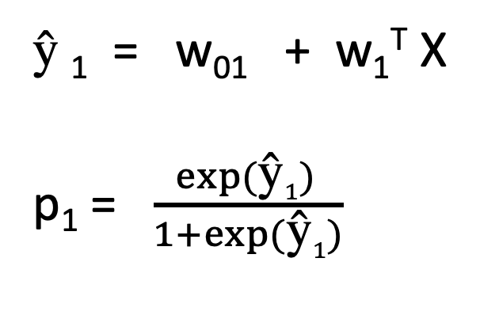
Logistic regression - ingredients
$\text{ŷ}$₁ = w₀₁ + w₁^{T} X
p₁ = $\frac{exp⁡(\text{ŷ}1) }{1+exp⁡(\text{ŷ}1)}$
Linear function of X
Limited to the range 0-1
We can interpret as a probability.
The logistic function is your function for
compressing the real line to the range (0,1).

Slide 20
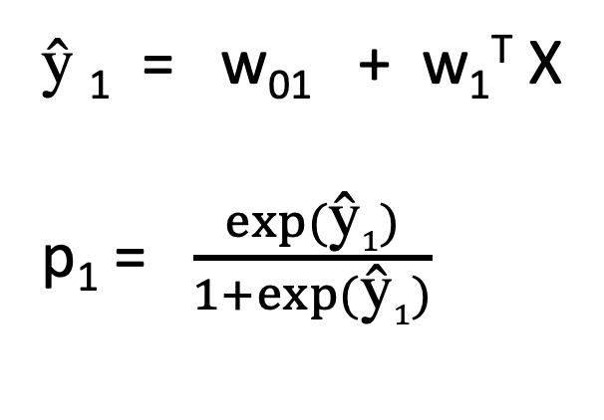
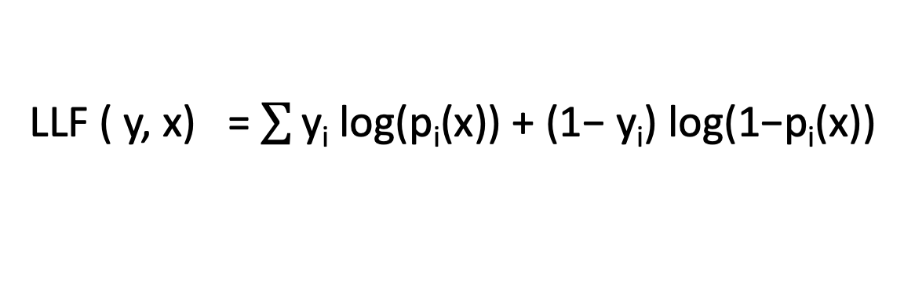
Logistic regression - ingredients
$\text{ŷ}$₁ = w₀₁ + w₁^{T} X
p₁ = $\frac{exp⁡(\text{ŷ}1)}{1+exp⁡(\text{ŷ}1)}$
Interpreted as a probability.
If y is true, log likelihood should be
log(p)
If y is false, log likelihood should be
log (1-p)
Logistic loss function
LLF ( y, x) = $\sum{\text{y}\text{i} \text{log}\text{(}\text{pi}\text{(}\text{x}\text{)) + (1− }\text{yi}\text{) }\text{log}\text{(1−}\text{pi}\text{(}\text{x}\text{))}}$
Here y represents my data (the true labels), and p
is my logistic predictions

Slide 21
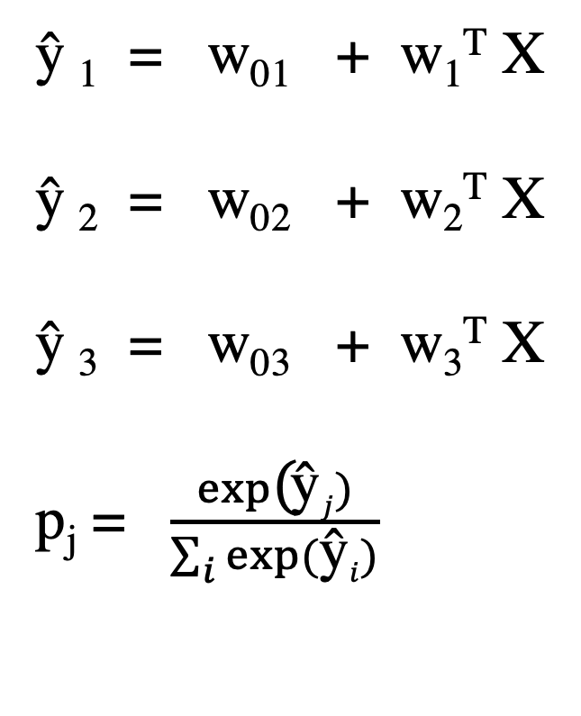
Generalize to estimate N probabilities
$\text{ŷ}$₁ = w₀₁ + w₁^{T} X
$\text{ŷ}$₂ = w₀₂ + w₂^{T} X
$\text{ŷ}$₃ = w₀₃ + w₃^{T} X
p_{j} = $\frac{exp\text{(}\text{ŷ}j)}{\sum_{i}{exp⁡(\text{ŷ}i)}}$

Slide 22
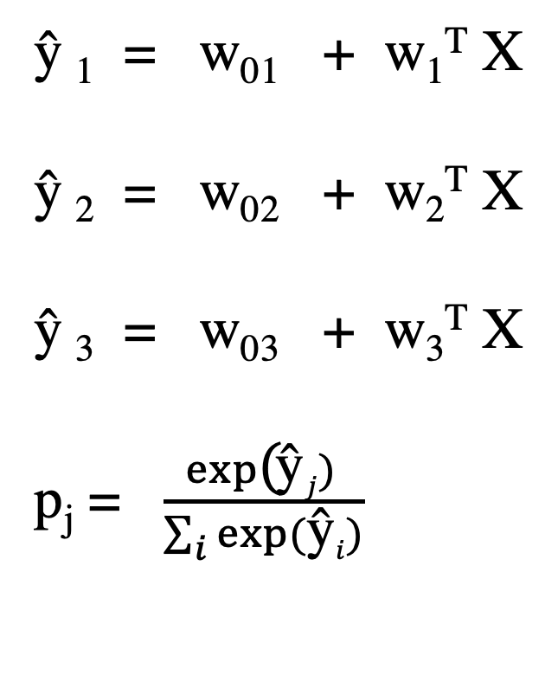
Generalize to estimate N probabilities
The class with the highest probability is
chosen as the predicted class label.
Since these are linear functions of X, the
decision boundaries are linear.
The loss term steers the coefficients to
values that discriminate.
$\text{ŷ}$₁ = w₀₁ + w₁^{T} X
$\text{ŷ}$₂ = w₀₂ + w₂^{T} X
$\text{ŷ}$₃ = w₀₃ + w₃^{T} X
p_{j} = $\frac{exp\text{(}\text{ŷ}j) }{\sum_{i}{exp⁡(\text{ŷ}i)}}$

Slide 23

Odds interpretation of logistic function
w₀₁ + w₁^{T} X = log $\frac{p(x)}{1−p(x)}$
linear function of (multivariate) X
odds in favor of x
Why might someone like accounting in log-odds terms ?

Slide 24
Naïve Bayesian Classifier
For classification (categories A, B, C given data D)
When you have a probability model for observations.
(Probability model is jargon for a set of outcomes and numbers for all their probabilities)
P(DA) , P(D|B), | and P(D|C) are known.
x ∈ {1, . . . , K} out of D kinds of observation
y = {1, . . . , C} out of C classes
θ_{c} = (prior) probaiblities of classes
p(x|y = c, θ) = 𝚷 p(x_{j} |y = c) θ_{jc}

Slide 25
Naïve Bayesian Classifier
Called naïve because the probabilities of the features are assumed to be independent.
What would correlated features generally do?
This is very much like our dice problem, and lends itself to simple bag-of-words models.
For classification (categories A, B, C given data D)
When you have a probability model for observations.
(Probability model is jargon for a set of outcomes and numbers for all their probabilities)
P(D|A) , P(D|B), and P(D|C) are known.
x ∈ {1, . . . , K} out of D kinds of observation
y = {1, . . . , C} out of C classes
θ_{c} = (prior) probaiblities of classes
p(x|y = c, θ) = 𝚷 p(x_{j} |y = c, θ_{c})

